Slide 1


Deep Reinforcement Learning to train locomotion activity in Robots
Balasurya M Ms. Surbhi Gupta
Prem Swarup Satsangi
Manuel George Thomas
Harsh Vyas
Marlin Shah

Slide 2
Introduction
Deep Reinforcement Learning is the combination of Reinforcement Learning and Deep Learning.
This field has recently been able to solve a wide range of complex decision-making tasks that were previously impossible for a machine.
Deep RL opens up many new applications in domains such as healthcare, robotics, smart grids, finance, and many more.

Slide 3
Simulation Environment Used
OpenAI Gym
Gym is a toolkit developed by OpenAI to develop and evaluate Reinforcement Learning algorithms.
It is an open source library in Python with many environments prebuilt under several categories such as Box2D, ToyText.
MuJoCo (multi-joint dynamics in contact) is a proprietary physics engine to facilitate development in robotics, biomechanics, graphics and animation.

Slide 4
Methodology / Model Used
Bipedal Walker is an environment in Box2D. The agent has two legs and the primary task is to navigate the environment without falling. We solved it using SAC and PPO2 algorithms.
Half Cheetah is an environment built on MuJoCo, resembling a cheetah, but with two legs. We also trained HalfCheetah using SAC and TD3 algorithms.

Slide 5
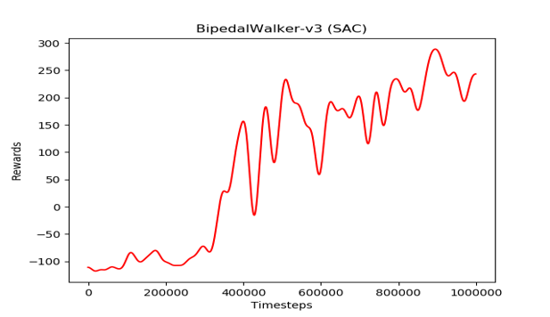
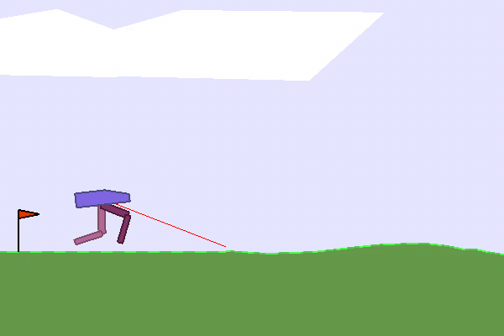
Results Achieved
Bipedal Walker trained using SAC
Learning Curve-Bipedal Walker

Slide 6
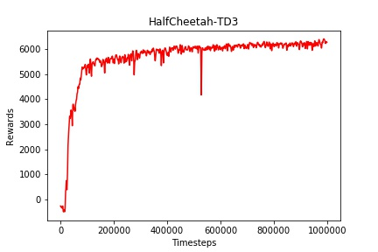
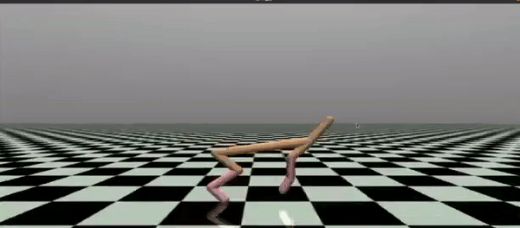
Results Achieved
Half Cheetah trained using TD3
Learning Curve-Half Cheetah

Slide 7
Conclusion
We have applied one of the state of the art algorithms in DRL to the task of robot locomotion.
But, if we had to train for a different kind of model, the hyperparameter tuning process could be exhausting.
Robot control is quite complex and very difficult to program manually. So, Deep Reinforcement Learning is most likely to be the future of Robotics and other related fields.

Slide 8
References
H. Van Hasselt, A. Guez and D. Silver, "Deep reinforcement learning with double Q-learning", AAAI, pp. 2094-2100, 2016.
Off-policy maximum entropy deep reinforcement learning with a stochastic actor- T Haarnoja, A Zhou, P Abbeel, S Levine
Scott Fujimoto, Herke van Hoof, David Meger “Addressing Function Approximation Error in Actor-Critic Methods”,2018.

Slide 9
Thank You

